Slide 1


CineReserve: A Dynamic Movie Booking Database System
by
Krishna 2410030418
Anjan 2410030386
Shashank 2410030167

Slide 2

CONTENTS
1. Introduction
2. Novelty of Developed Methodology
3. Adaptability of Methodology
4. Methodology Evaluation
5. Dissemination and Accessibility
6. Summary

Slide 3
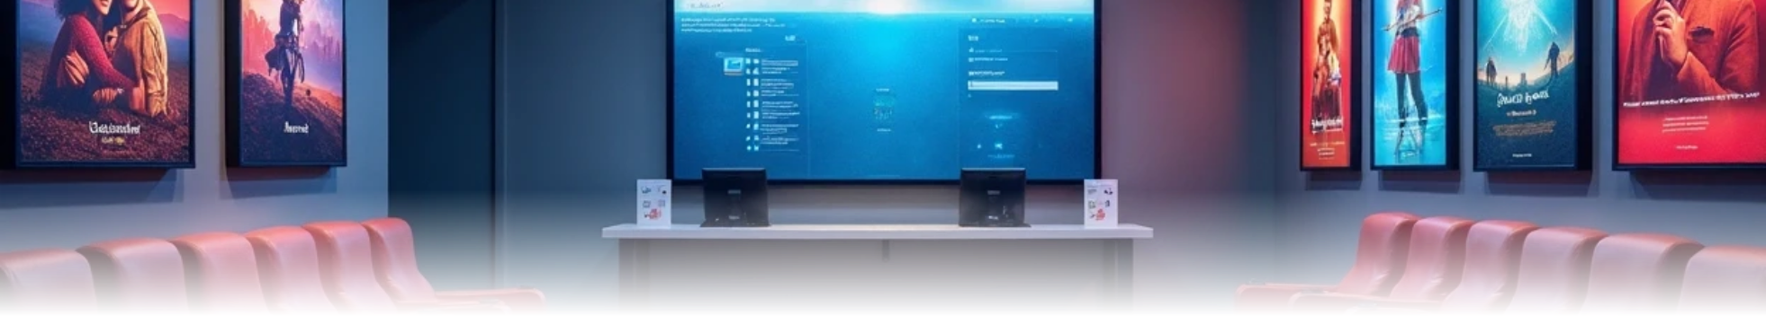
1. Introduction
In today's fast-paced digital world, moviegoers demand a seamless and reliable online booking experience. However, many existing systems falter under pressure, especially during blockbuster releases. They often suffer from slow response times, frustrating seat-booking conflicts, and data inconsistencies.
This project, CineReserve, was developed to directly address these critical challenges. Our goal was to engineer a robust, scalable, and high-performance database system from the ground up. We aimed to create a backend that not only manages complex transactions with perfect integrity but also provides an effortlessly smooth experience for the end-user and a powerful, easy-to-use tool for theater administrators. CineReserve is our solution to the modern demands of online ticketing.

Slide 4


2. Novelty of Developed Methodology
Hybrid Database Architecture
Optimistic Locking Mechanism
Dynamic Pricing Algorithm
Our unique hybrid database architecture uses both a relational database for ACID-compliant transactions and a NoSQL database for flexible data like reviews.
A custom-developed optimistic locking mechanism for real-time seat selection.
Implementation of a dynamic pricing algorithm.

Slide 5




3. Adaptability of Methodology
1
2
3
Modular and Extensible Design
High Scalability
Platform-Agnostic
The system demonstrates high scalability through schema normalization (3NF).
The architecture is platform-agnostic thanks to a RESTful API.
It features a modular and extensible design for future enhancements.

Slide 6
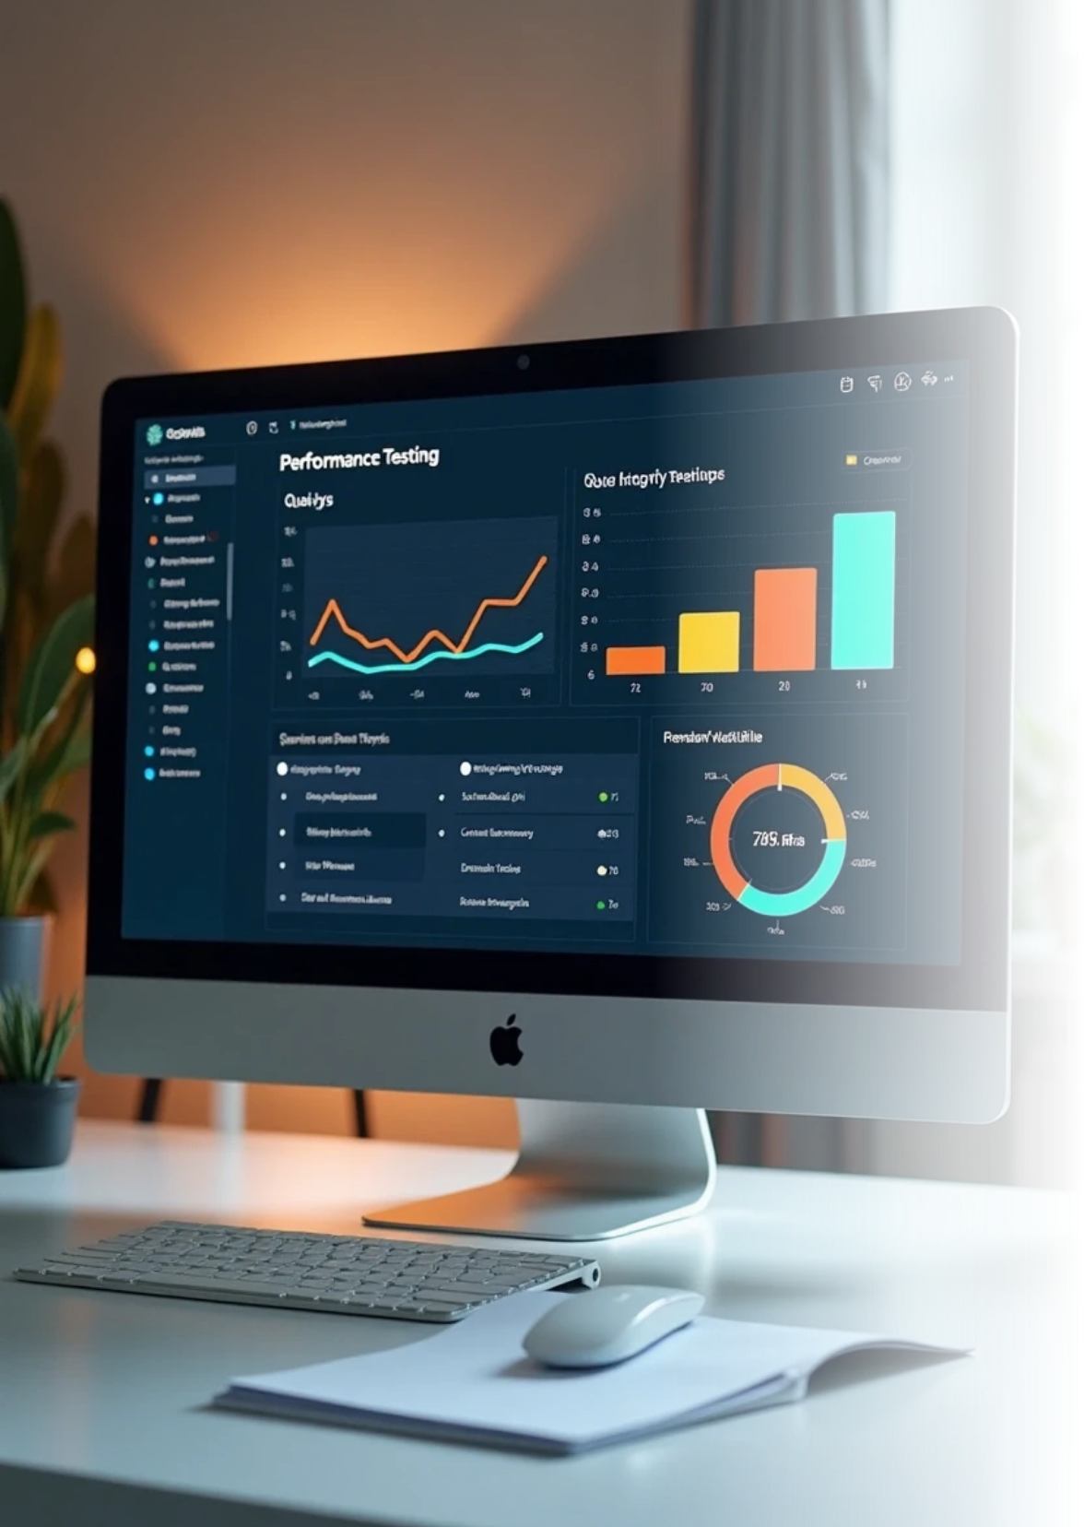

4. Methodology Evaluation
Performance Testing
Successful results from performance testing show sub-200ms query times under load.
Data Integrity Validation
Data integrity was validated using constraints and triggers, confirmed by a 95% user satisfaction rate in UAT.

Slide 7






5. Dissemination and Accessibility
1
User-Friendly Access
The system is accessible via a user-friendly web application and a secure admin dashboard.
2
Administrator Dashboard:
A secure, role-based admin panel allows theater managers to add/update movie listings, manage showtimes, view booking reports, and override seat availability, making theater management efficient.

Slide 8
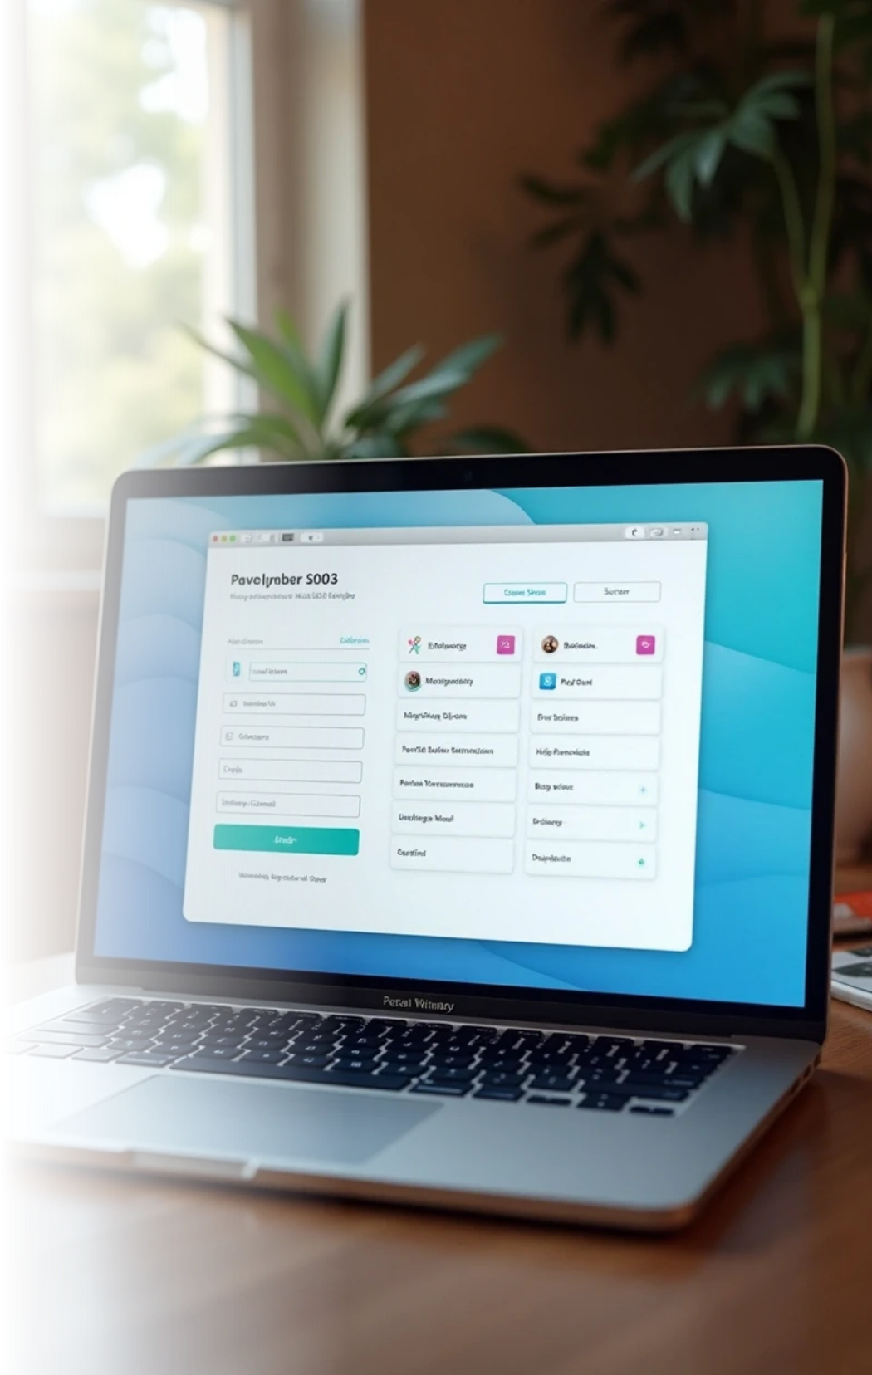
6. Summary
The CineReserve project is a high-performance database management system designed to create a modern, reliable, and scalable online movie booking platform. Its core innovation is a hybrid database architecture that leverages a relational SQL database for transactional integrity in bookings and payments, alongside a flexible NoSQL database for managing dynamic content like movie details and user reviews. Enhanced with a custom real-time concurrency control mechanism to prevent booking conflicts, the system ensures a seamless user experience through a web application for customers and a secure dashboard for administrators. Rigorous testing has validated the system's efficiency, data integrity, and ability to handle high traffic, making it a robust solution to the common challenges of online ticketing.

Slide 9

Thank You

